Slide 1
Day 4 – Asset Accounting overview
Notes:
This In-house course was developed to meet the needs of SAP R/3 Consultants working at Capgemini. This course is designed to present a high level view of Asset Accounting Overview and to provide the Consultants with basic information about how to use this Functionality.
More in-depth courses have been developed to train Consultants in specific areas discussed during this course.
Your comments at the conclusion of this training session are appreciated and will help us better tailor future courses to meet your training needs.

Slide 2
Contents :
1) Purpose, Use , Challenge
2) Organization structure
3) Chart of depreciation
4) Depreciation calculation
5) Asset classes

Slide 3
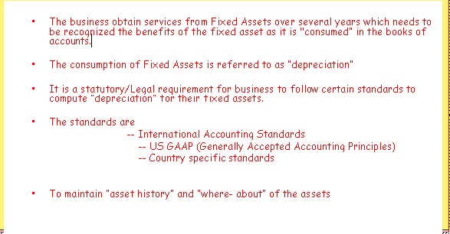
Purpose
Asset Accounting is much more that managing, supervising of assets and accounting of the depreciation.

Slide 4
Asset Definition
A fixed asset is defined as any asset, tangible or intangible, acquired for retention by an entity for the purpose of providing a service to the business, and not held for resale in the normal course of trading.
Examples of tangible fixed assets include land and buildings, plant and machinery, fixtures and fittings, motor vehicles and IT equipment.
Intangible assets lack physical substance and usually are very hard to evaluate. They include patents, copyrights, goodwill, trademarks, trade names, etc.

Slide 5
Some of other way expressions
Fixed Assets are the non-liquid assets that are required for the company's day-to-day operations.
Fixed Assets are the assets which cannot easily be converted into cash This can be compared with current assets such as cash or bank accounts, which are described as liquid assets.

Slide 6
Meaning of depreciation
A portion of the benefits of the fixed asset will be used up or consumed in each accounting period of its life in order to generate revenue.
In essence, depreciation involves allocating the cost of the fixed asset (less any residual value) over its useful life. To calculate the depreciation charge for an accounting period, the following factors are relevant:
- the cost of the fixed asset;
- the (estimated) useful life of the asset;
- the (estimated) residual value of the asset.

Slide 7
Depreciation Methods
The total amount to be depreciated over the life of a fixed asset is determined by some systematic calculations
So how much of this depreciable amount is charged against profits in each accounting period?
A depreciation method is required to allocate, in a systematic way, the total amount to be depreciated between each accounting period of the asset's useful economic life.
There are various methods of depreciation available. However, most businesses appear to adopt one of the two methods described below.

Slide 8
Method 1 - Straight-line depreciation:
The straight-line method of depreciation is widely used and simple to calculate. It is based on the principle that each accounting period of the asset's life should bear an equal amount of depreciation
Method 2 - Reducing balance method:
The reducing balance method of depreciation provides a high annual depreciation charge in the early years of an asset's life but the annual depreciation charge reduces progressively as the asset ages.
To achieve this pattern of depreciation, a fixed annual depreciation percentage is applied to the written-down value of the asset. Thus, depreciation is calculated as a percentage of the reducing balance.

Slide 9
Asset Accounting Functions
Use
Assets are procured for day-to-day services in business
Assets are procured for Investment purposes
Assets are procured through project systems
Assets are procured through Internal Order settlements
Maintaining “Asset history” and better control on “where – about” of the assets

Slide 10

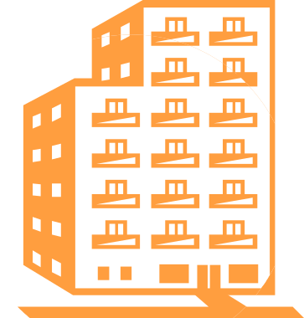

Challenges
Depreciation needs to be computed under various laws for the same period for the same asset.
How many computation methods (depreciation keys) needs to be defined?
How to change over the depreciation methods?
How to account for Break down costs?
How to capitalise for Asset under construction (AUC) assets?
How to made settlements to AUC assets?
How to maintain settlement and distribution rules?
How to procure assets through material management?
How to maintain assets through Inventory management?

Slide 11




FI-AA Integration in R/3
LC
FI
Consolid.
General Ledger
Corp. val.
Bal. Sheet
Local val.
P&L
CO
Profit Center
AA
Bal. Sheet
Asset
IM
Investment
measure
P&L
CO
MM
Cost Center
Purchasing
Goods rec. / Whse
APC
PP
Planned Costs
Depreciation
Production
(order)
Actual Costs
PM
Equipment
Actual costs
Notes:
The Asset Accounting is a sub-module which can manage fixed assets of an organization.
In Financial Accounting system, asset accounting serves as a sub-ledger to the General Ledger, providing detailed information on asset-related transactions (acquisitions, transfers and retirements).
Depreciation, interest and replacement values are periodical postings.
Asset accounting deals with normal assets, assets under construction (AuC), leased assets, low value assets, etc..
As a result of the integration in the R/3 System, FI-AA transfers data directly to and from other systems.
For example, in Materials Management (MM) or Production Planning (PP) components can post directly to FI-AA. When an asset is purchased or produced in-house,
The Plant Maintenance (PM) component can settle maintenance activities that require capitalization to assets.

Slide 12
Posting to Subsidiary ledger in AA - Automatic posting to General Ledger in FI
Subsidiary Ledgers :
General Ledgers:
Asset-machine A/c
Fixed Assets A/c (Recon A/c)
9000
9000
Payables A/c (Recon A/c)
Vendor A/c
9000
9000

Slide 13
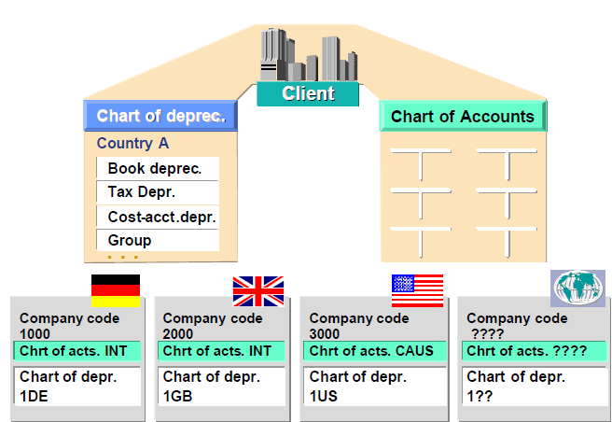
Organization structure
Each company code uses one chart of accounts and one chart of depreciation.
All or several company codes can work with the same chart of accounts and the same chart of depreciation. The chart of depreciation is always country-specific.
Notes:
Asset Accounting (FI-AA) works with the chart of accounts assigned to the
company code in Financial Accounting (FI). You can modify the chart of
accounts to fit your requirements (for example, global, industry-specific, or
country-specific)
The chart of depreciation is always country-specific. SAP provides model charts
of depreciation for many countries. These contain predefined depreciation areas,
but you can also define your own chart of depreciation (by copying and changing).
Each company code uses one chart of accounts and one chart of depreciation.
All or several company codes can work with the same chart of accounts and the
same chart of depreciation.

Slide 14
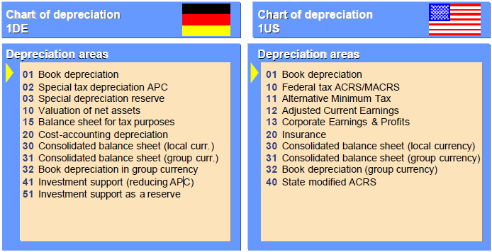
Organization structure
Each depreciation area represents a specific type of valuation
The depreciation areas are defined with a two-digit numeric key. The numeric keys represent depreciation terms that you can enter in the asset master record or in the asset classes
Notes:
Each depreciation area represents a specific type of valuation (for example, book
depreciation or tax depreciation). You can also define your own depreciation
areas in the chart of depreciation.
The depreciation areas are defined with a two-digit numeric key. The numeric
keys represent depreciation terms that you can enter in the asset master record or
in the asset classes. Values and depreciation are posted to the general ledger.
Depreciation area 01 is the leading depreciation area. Values and depreciation are
posted to the general ledger.

Slide 15
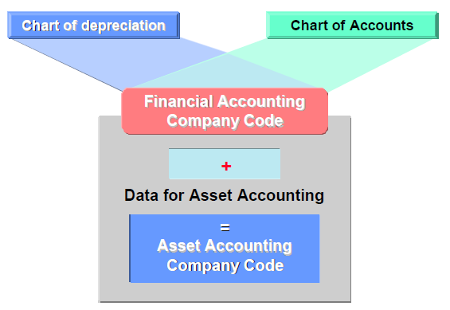
Organization structure
Company code is created in Financial Accounting.
Assign the chart of depreciation to the company code.
The necessary data for asset accounting is added to the company code.
The company code is now available for use by Asset Accounting.

Slide 16
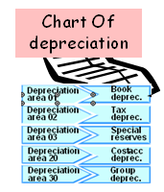

The Chart of Depreciation
Chart of
accounts
FI
+
Data for
AA
DATA for AA
=
=
FI AA
The depreciation areas show the valuation of assets for given purposes (such as book or tax depreciation or depreciation for cost accounting).
Notes:
The chart of depreciation is a catalog of country-specific depreciation areas. Chart of depreciation is a list of depreciation areas which are all useful for business, legal requirements and statutory requirements.
SAP supplies charts of depreciation as references that are based on the requirements of each country. You can create a new chart of depreciation by copying one of the reference charts of depreciation
In your chart of depreciation you can delete the depreciation areas those you not required. This deletion must be done before creation of any asset
The depreciation areas are identified in the system by a two-character numeric key.
They contain depreciation terms that you can enter in the asset master record or in the asset classes.

Slide 17
Depreciation area 01 is the leading depreciation area. Values and depreciation are posted to the general ledger.
Other depreciation areas may show:
. Country-specific valuation (for example, net-worth tax, state calculation)
. Values or depreciation that differ from area 01 (for cost-accounting reasons ,for example)
. Consolidated versions in company code or group currency
. Book depreciation in group currency
. Difference between book and country-specific tax-based depreciation
Different depreciation areas can have the same values and depreciation terms, but can be displayed in different currencies (for example, areas 01 and 32 or areas 30 and 31).
Notes:
Depreciation area 01 is the leading depreciation area. Values and depreciation are
posted to the general ledger.
Other depreciation areas may show:
. Country-specific valuation (for example, net-worth tax, state calculation),
. Values or depreciation that differ from area 01 (for cost-accounting reasons,
for example)
. Consolidated versions in company code or group currency
. Book depreciation in group currency
. Difference between book and country-specific tax-based depreciation
Different depreciation areas can have the same values and depreciation terms, but
can be displayed in different currencies (for example, areas 01 and 32 or areas 30
and 31).
You have to specify which depreciation types and special valuations (such as
interest) are allowed in your depreciation areas. The standard depreciation areas
already have the necessary settings.
4

Slide 18
Depreciation
In each depreciation area, you can specify the type of depreciation and the transaction types you want to manage.
It does mean different types of depreciation could be computed at a time for an asset, such as -
Ordinary depreciation:
Ordinary depreciation is the planned reduction in asset value due to normal wear and tear.
Special depreciation:
Special depreciation represents depreciation that is solely based on tax regulations.
Unplanned depreciation:
Unplanned depreciation is concerned with unusual circumstances, such as damage to the asset, that leads to a permanent reduction in its value.

Slide 19
Depreciation Calculation
Depreciation key defined at chart of depreciation level
Depreciation key
Assigning
Depreciation class
Change Over method
Cut off value key
Define Calculation
Methods
Base Method
Declining Balance method
Maximum amount method
Multi level method
Periodic control method
Notes:
The roles of different calculation methods in a depreciation key:
Base Method:
Type of depreciation : Ordinary depreciation, Dep. Method : Stated percentage
Declining balance method:
For each declining-balance method, specify:
A multiplication factor for determining the depreciation percentage rate
An upper limit for the depreciation percentage rate
A lower limit for the depreciation percentage rate
Maximum amount method:
The calculation method contains a maximum depreciation amount that is not allowed to be exceeded before a certain calendar date. If the depreciation calculated by the system exceeds this maximum amount, then the system reduces depreciation to this maximum amount.
Multi level method: Each level represents a validity period for a given percentage rate.
Period control method:
Assign period control keys to the period control methods for:
Acquisition transactions, Subsequent acquisitions, Retirements and transfers
Other important in puts:
Depreciation class: Straight line or Declining balance method
Change over method:
Specifies when the changeover to a different phase of the depreciation key takes place.
Cut off value key: Scrap value

Slide 20
Depreciation posting pre-requisites
Depreciation area
Depreciation key
Depreciation terms - Dep. Start date, etc.,
Specify document type for dep. Posting
Document type AF is the standard document type for depreciation postings.
Specify dep. Posting interval and posting rules
Specify rounding off Net book value and/or depreciation

Slide 21
Calculating Depreciation Values
Master record:
Book depreciation area
Transaction
Depreciation terms
Asset value display
Depreciation key LINR
  Straight-line
APC
10000
Ord. Dep.
1000-
Useful Life
  10 Years
NBV
9000
Annual computation
Display Depreciation Calculation
Base value
10000
Percentage rate
10%
Amount
1000
Notes:
The asset master record contains the depreciation terms.
In the above example, the system calculates the annual depreciation from the depreciation key and the useful life.
According to the purpose of the depreciation area, other terms, like revaluation or imputed interest, are also calculated.
As a general rule, the system determines the depreciation start date from the asset value date of the first acquisition posting.
The asset value display shows the values and the depreciation for every transaction and each area.
The planned values contain the values and the different value adjustments for each area.
From Menu, you can display the calculation of the depreciation values.
It is to be noted that changing the Customizing definition of the depreciation keys does not automatically lead to a correction of depreciation values that have already been calculated for individual assets.
If you change the depreciation terms in an asset, the system will recalculate the asset values accordingly.
For corrections, you have to execute a recalculation of depreciation.
Periodic processing comprises those tasks in Asset Accounting that must be performed at periodic intervals.
At present, only the values of one depreciation area can be automatically posted online in Financial Accounting; therefore, the changes to asset values (transactions) from other areas with automatic posting have to be posted periodically to the appropriate reconciliation accounts.
The posting session also posts the different depreciation types, interest and revaluation, in addition to the writing-off and allocating special reserves. The system does not create individual documents, only summarized posting documents (per business area and per account determination).

Slide 22
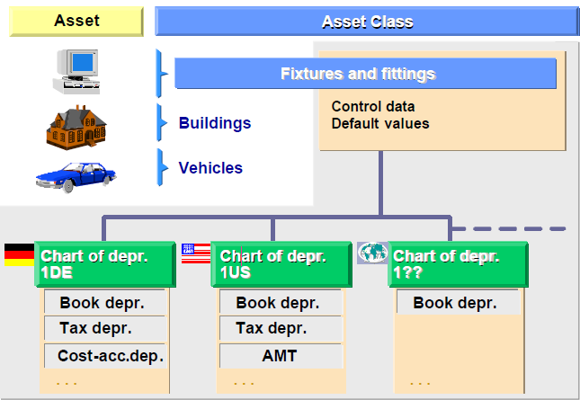
Asset Classes
Fixed assets are classified into asset classes. Some examples of asset classes could be vehicles, furniture, or machines.
The asset class consists of a master data section and a depreciation area section.
Asset classes are created at client level. They are then assigned to at least one chart of depreciation.
Several charts of depreciation can also be assigned to an asset class. This ensures that the asset class catalog is uniform, despite using different depreciation areas.

Slide 23
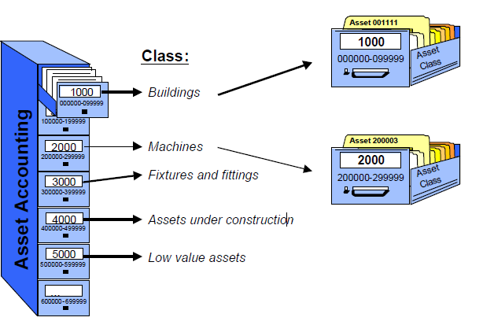
Asset Classes
The Asset class is the main criterion for classifying assets. Each asset is assigned to only one asset class.
Assets that are to appear in different places/balance sheet items (for example, buildings and machines) have to be assigned to different asset classes.
There is also at least one special asset class each for assets under construction and low value assets.

Slide 24
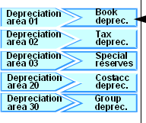
Asset Class Portfolio
Chart
of
Chart of
depreciation
accounts
Asset Class
Control
Parameters
■
Account determination
■
Screen Layout
■
Number Range
Create Asset Master
Notes:
Asset classes are the most important means of structuring fixed assets according to the requirements of an Organization. The definitions of the asset class apply to all company codes in a client. Typical asset classes include:
Land & Buildings, Machinery and Equipment, Furniture and Fixtures, AUC assets, LVA assets, Intangible assets
An asset class consists of two main sections:
a master data section with default values for the administrative data in the asset master record,
a valuation section (Depreciation Areas) with control parameters for valuation and depreciation terms.
The asset class is a selection criteria in all standard reports in FI-AA.
Basic configuration elements include:
1) Account determination (assignment of G/L Accounts) 2) Number range 3) Screen layout for Master data screens
An essential function of the asset class is to establish the link between the asset master records in Asset accounting and the relevant G/Ls in FI (for APC, sale, profit/ loss on sale of asset, Accumulated dep., depreciation, Interest accounts, etc.)

Slide 25
Asset Classes: Account determination
For several similar asset classes ,different account determination keys can be used, although their values are all updated to a single balance sheet account.
Several asset classes can use the same account determination key if they use the same chart of accounts and post to the same G/L accounts.
If different charts of accounts are used, only one account determination key is needed to post asset values of all asset classes to different accounts in the different charts of accounts.
To define acquisition/retirement accounts, the necessary G/L accounts for acquisition, retirement, balance sheet revaluation, and cost amounts that are not capitalized (cost element and account for non operating expense or capitalization differences) will have to be entered.

Slide 26
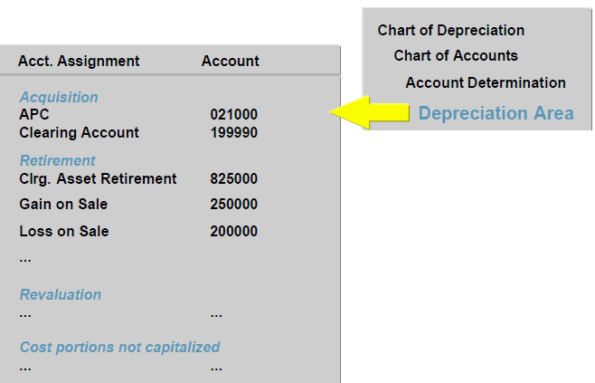
Asset Classes: Account determination

Slide 27
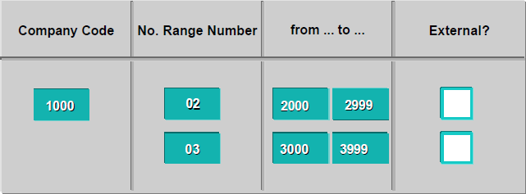
Asset Classes: Number ranges
The number range controls the assignment of the number of the asset master record. It can be defined as either internal or external.
Internal :The system automatically assigns the next available number in the numerical sequence in the defined number range interval.
External :The number is assigned by the user or by another system.
Each company code can have its own number range, or company codes can share number ranges.

Slide 28
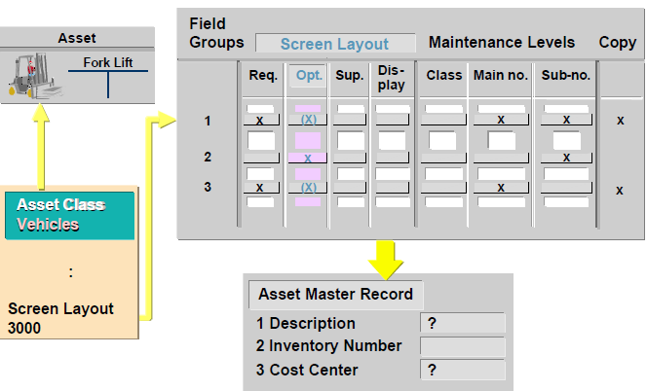
Asset Classes: Screen layout
The screen layout specifies which input fields are displayed in the asset master record, and whether they are required entry or optional fields/suppress/display only
The screen layout specifies the maintenance level of master data fields i.e. level at which each field can be maintained –Asset Class/Asset no./Sub number
It also has the reference indicator controls which field contents of an asset area can be copied when that asset is used as a reference for creating a new asset master record.

Slide 29
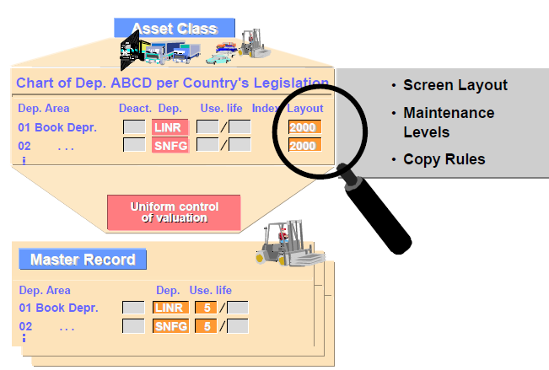
Asset Classes: Screen layout for depreciation
The screen layout rule defined here applies to the valuation fields in the depreciation area.
SAP supplies screen layout rules 1000 and 2000 in the standard system.
These screen layout rules also contain a maintenance level. The maintenance level guarantees that depreciation is controlled uniformly. Depreciation can be configured to be uniform at same at asset class level or Main Asset number or the Sub Asset.

Slide 30
Asset Classes: Account assignment objects
Account assignment objects must be activated before they can be maintained in the master data.
Path :
Integration with the General Ledger → Additional Account Assignment Objects → Activate Account Assignment Objects.
Depreciation (cost-accounting) can be posted to account assignment objects, or can be used for APC (acquisition and production costs) postings, such as direct capitalization as part of an investment measure or for (statistical) budget monitoring for asset purchase. It can be posted to the following objects:
. Cost center
. CO internal order
. WBS element
. Real estate object (building or property)
. Various objects from the PSM (Public Sector Management) component

Slide 31
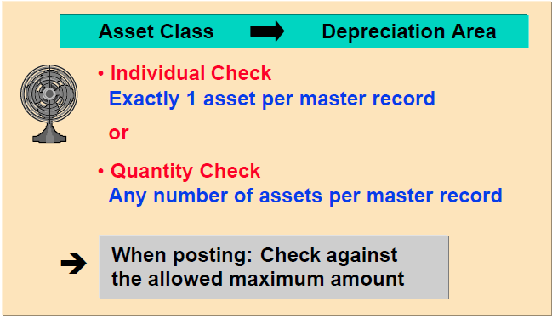
Asset Classes: Low Value Assets
Low value assets (LVAs) can be managed using individual management or collective management .For each type of management, a separate asset class has to be set up .
In case of collective management of LVAs, a base unit of quantity in the asset class is to be entered.
A check of the maximum amount in the depreciation areas of the asset class for LVAs should also be set.

Slide 32


Special Asset Class: Low Value Assets
Asset class Depreciation area
Individual check
One asset per master record
or
Quantity check
Any number of assets per master record
When posting: Check against
the maximum amount allowed
Notes:
In general, low value assets are fully depreciated in the year of purchase or in the period of acquisition. This depreciation can be achieved by using the standard depreciation key GWG
The use of low value assets allow you to track assets in the asset register.
Other considerations:
You can choose whether to manage low value assets (LVAs) using individually or collectively.
For each type, you need to have a separate asset class.
If we choose collective management of LVAs, you have to enter a base unit of quantity in the asset class.
We need to define the maximum amount check in the depreciation areas in the asset class.
We enter the maximum allowed amount in the IMG under ”Valuation, Amount specifications” at the level of the company code.

Slide 33
Asset Classes: Asset Under Construction
Assets under construction (AuC) require a separate asset class and corresponding G/L account, because they have to be shown separately in the balance sheet.
Normally depreciation key 0000 is used to ensure that depreciation is not calculated for AuC in depreciation areas for the balance sheet. However, special tax depreciation and investment support are possible even on AuC.
It is also possible to post down payments on assets under construction.
Even after an asset under construction has been fully capitalized, you can still post credit memos to it. However, you have to allow negative APC.
To manage more extensive asset investments, Investment Management (IM) integrates internal orders and projects with the AuC and allows detailed monitoring.

Slide 34


Special Asset Class:
Assets Under Construction
Class: Assets u. const.
AUC assets could be managed for line item settlements
AuC status
Depreciation areas
Book dep.
Tax dep.
Dep. Key
0000
0000
Notes:
Assets under construction require a separate asset class with their own respective G/L accounts.
Choosing the depreciation key ‘0000' ensures that depreciation is not calculated for the asset under construction in the depreciation areas.
However, special tax depreciation and investment support are possible even on assets under construction.
It is possible to post down payments on assets under construction.
We can manage more extensive asset investments in the IM (Investment Measures) module.
We can integrate internal orders and projects with assets under construction.

